Slide 1
Methodology and Meta-Model
Shyam Bhat
Wipro Automotive Domain

Slide 2
What is Methodology
Methodology is guidelines provided by Autosar Consortium, about how to develop a Autosar based system.
It provides guidelines regarding
Tools
Work products
Templates
Development process and flow
The AUTOSAR methodology is structured into several domains of development:
Virtual Functional Bus
System
Software Component
Basic Software
ECU
Methodology describes the activity and development process of Autosar based software by means of Methodology Library elements. These elements are
Task Definition
Work Product Definition
Role Definition
Tool Definition
Guidance

Slide 3
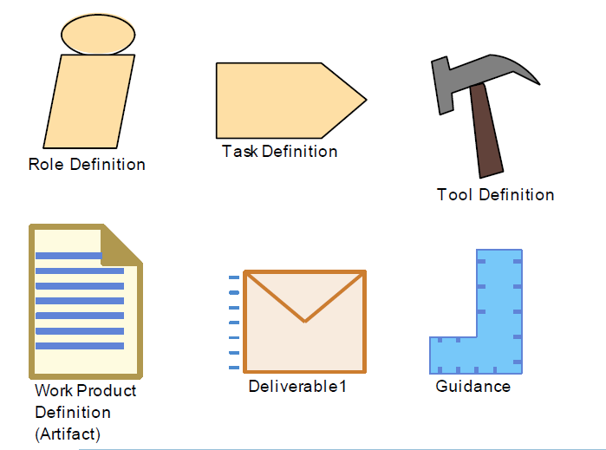

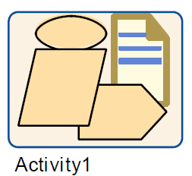
Symbols of AUTOSAR Methodology Library Elements

Slide 4
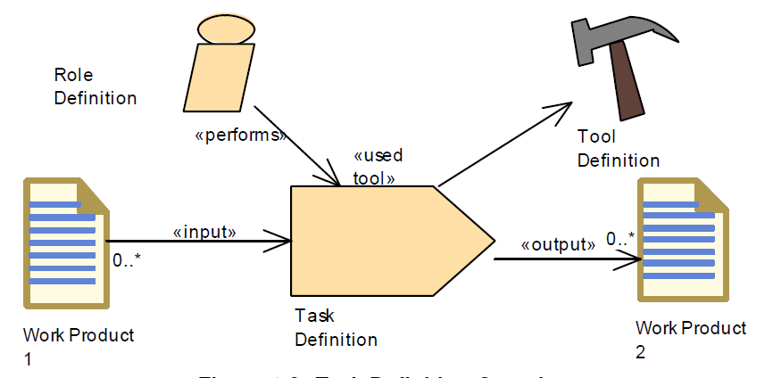
Methodology Library Element – Task
Task Definition: According to the SPEM meta model, a Task Definition is an assignable unit of work that is being performed by specific Roles. The duration of a task is generally a few hours to a few days. Tasks usually generate one or more work products. Each Task is associated to input and output Work Products. Inputs are differentiated in mandatory and optional inputs. A Task is used as one element among others to define a Process.

Slide 5
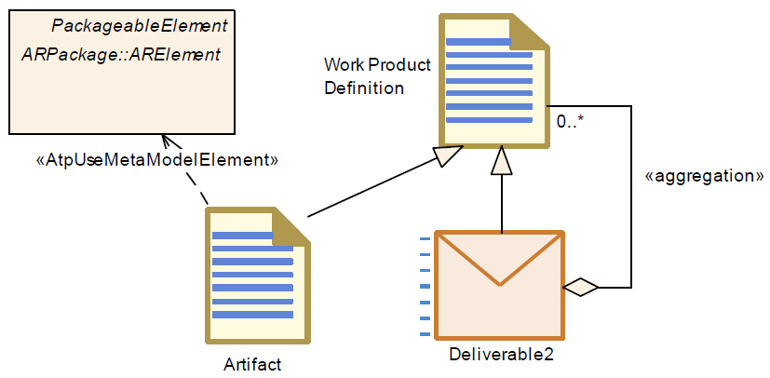
Methodology Library Element – Work Product
Work Product Definition: According to the SPEM meta model, a Work Product Definition is used, modified, and produced by Tasks (i.e. a task input and output). Work Products are in most cases tangible work products consumed, produced, or modified by Tasks.
A Work Product can be of type Artifact or Deliverable.
Artifact: A tangible Work Product that is consumed, produced, or modified by one or more Tasks. Example of artifacts: AUTOSAR XML, Source Code, Object Code, Executable and Text
Deliverables are used to represent an output from a process that has value, material or otherwise, to a client, customer, or other stakeholder.

Slide 6
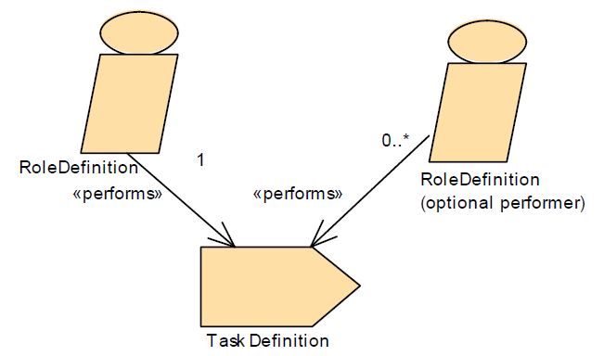
Methodology Library Element – Role
Role Definition: According to the SPEM meta model, Role Definitions define responsibilities of an individual or a set of individuals and thereby define a set of related skills, competencies, and qualifications needed to perform a Task. A Role can be filled by one person or multiple people, one person may fill several Roles. Each Role performs Tasks.
Examples of Roles are ”System Engineer”, ”Safety Engineer”, or ”Software Developer”.

Slide 7
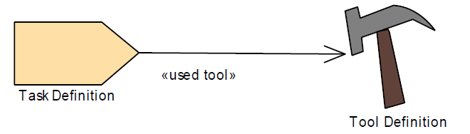
Methodology Library Element – Tool
Tool Definition: According to the SPEM meta model, Tool Definitions can be used to specify a tool’s participation in a Task. A Tool Definition describes the capabilities of a general purpose tool, or any other automation unit that supports the associated Roles in performing the work defined by a Task. A Tool can identify a resource as useful, recommended, or necessary for a task’s completion. A Tool can also be used to manage one or more Work Products.
The AUTOSAR Methodology uses the Tool Definition to describe AUTOSAR specific (e.g. Software Component Contract Generator) and other general Tools (e.g. Compilers). The relationship of a Tool to a Task shows which Tools a Role will need to perform the Task.

Slide 8
What is an Activity
In the SPEM meta model, an Activity is the main building block to define a process. An Activity is usually a defined task or work to be done that is commonly executed in one sequence. Methodology defines an activity using the Library elements.
Activities can include other Activities and thereby often decompose a flow of work and show which Activity precedes other Activities. At the lowest level, Activities are collections of work breakdown elements which in AUTOSAR methodology are Tasks, Roles, and Work Products.
A Process is a special Activity in the SPEM meta model that describes a typical structure of development projects or parts of them. A Process focuses on the lifecycle and the sequencing of work in breakdown structures. Processes contain sequences of Task and Activities and thereby express a lifecycle of the product under development. Processes also define how to get from one milestone to the next by defining sequences of work, operations, or events

Slide 9
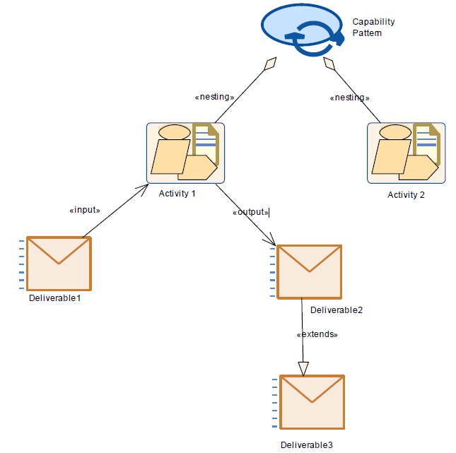
What is a Capability Pattern
The methodology library elements are referenced in order to describe together with activities the so-called Capability Patterns.
Capability Pattern is a process pattern that contains a reusable set of activities.
Capability Patterns can be assembled to larger Capability Patterns that describe development processes or parts of a development process including typical use cases.

Slide 10
Autosar Metamodel - Links
Autosar Meta-Model for Release 4.4.0 can be found here: https://www.autosar.org/fileadmin/Releases_TEMP/Classic_Platform_4.4.0/MethodologyAndTemplates.zip
Also in GitHub Repository : https://github.com/VicharaVandana/Autosar
If you unzip, in the folder, you have a Enterprise Architect project file AUTOSAR_MMOD_MetaModel.eap You need to open this in Enterprise Architect tool from Sparx Systems.
The rules and guidelines for the modelling language in this meta-model document are UML2.0 defined by OMG [Object Management Group] and this metamodel is called as SPEM [Software Process Engineering Meta-Model]
The SPEM specification document can be found at : https://www.omg.org/spec/SPEM/2.0/PDF

Slide 11
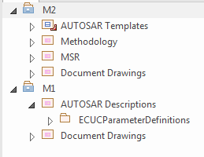
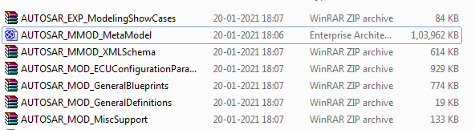
Autosar Metamodel
If you open AUTOSAR_MMOD_MetaModel.eap file, then you will find 2 nodes: M1 and M2
M2 : Meta Model. All MMOD termed files and documents in the folder are related and comes from this M2 like the templates and methodology all the procedures and activities etc.
M1 : Model. All MOD termed files and documents in the folder are related and comes from this M1. M1 is derived and hence an instance of M2 metamodel.

